Slide 1

School of Computing Science and Engineering
Appendix 2
Program: B Tech
Course Code:BCSE3016
Course Name: Web Tech (PBL MODE)

Slide 2
School of Computing Science and Engineering
Project Name: Library Management System
Team No. :12
Batch :8
Name : Satyanarayan Pandey

Slide 3
School of Computing Science and Engineering Course Code :BCSE3016 Course Name:WEB TECH
Course Outcomes :
Course outcomes (COs)
CO1 | Understand web development strategies and design web pages using HTML, XHTML.
CO2 | Design and enhance static web pages using CSS and XML.
CO3 | Develop a dynamic webpage by the use of java script with its features such as event handling, validation, etc.
CO4 | Write a server side java application called JSP to fetch data sent from client and store it on database.
CO5 | Build Dynamic web site using server side PHP Programming and establish Database connectivity.
Program Name: Program Code:

Slide 4
School of Computing Science and Engineering Course Code :BCSE3016 Course Name: WEB TECH
Course Prerequisites
Object Oriented Programming,
Database Management Systems
Program Name: Program Code:

Slide 5
School of Computing Science and Engineering Course Code :BCSE3016 Course Name: WEB TECH
Syllabus
Unit I: Introduction to web and HTML 8 lecture hours
Introduction to web, web development strategies, web team. HTML introduction: basic tag, elements, attributes, formatting, comments, marquee, list, table, images, frames, forms; Links : text, image and email. XHTML: Syntax and Semantics.
Unit II: CSS and XML 8 lecture hours
CSS : color, background, fonts, images, link, table, margins, lists, border, paddings, scroll, class.
CSS3 : border Image, round corner, text shadow, layers.
XML: DTD, XML schemes, presenting and using XML.
Unit III: JavaScript 8 lecture hours
Java script: Introduction, documents, forms, statements, functions, objects; Event and event handling; Error handling; validation.
Unit IV: JSP 8 lecture hours
Java server pages (JSP), JSP application design, declaring variables and methods, debugging, sharing data between JSP pages, JSP objects, Session, development of java beans in Jsp, data base action with JSP.
Program Name: B TECH Program Code:

Slide 6
School of Computing Science and Engineering Course Code :BCSE3016 Course Name: WEB TECH
Syllabus cont.
Unit V: PHP 8 lecture hours
PHP (Hypertext Preprocessor): Introduction, syntax, variables, strings, operators, if-else, loop, switch, array, function, form ,mail, file upload, session, error, exception, filter, PHP-ODBC.
Text Books:
T1. Ivan Bayross -Web Enabled Commercial Application Development Using HTML, DHTML, Java Script, Perl, CGI-2000
T2. Uttam/Roy,” WEB Technology”, Oxford Publication.
Reference Books:
R1. Xavier, C, “ Web Technology and Design” , New Age International
R2. Deitel, “Java for programmers”, Pearson Education
R3. Ramesh Bangia, “Internet and Web Design” , New Age International
R4. Jackson, “Web Technologies” Pearson Education
R5. Patel and Barik, ”Introduction to Web Technology & Internet”, Acme Learning
Program Name: B TECH Program Code:

Slide 7
Index
School of Computing Science and Engineering Course Code :BCSE3016 Course Name: WEB TECH
Problem specification
Concept development (like use case diagram, DFD, etc.)
Content design
Screen Shots
Testing
Extra curriculum
Program Name: B TECH Program Code:

Slide 8
1:-Problem Specification
To devise a software for providing information and simplifying the procedure for Library Management.
To Provide a Comprehensive Set of Features
To Maintain a record of every book in the library and the Students’ data.
To keep the record of Books Circulation.
To Update the Collection of Books.
To Order More books as per requirements.
2:-Existing System
Handwritten Record
Fast Report Generation is not possible
Tracing Books is difficult
Information about issue or return Books is not properly maintained

Slide 9
3:-Concept Development
We will be Having different features like
Signing In and Signing Up.(Admin/Student)
Messaging Feature.(Admin)
Storing Students’ Data.(Admin)
Viewing The Entire Collection of Books.(Admin/Student)
Adding new arrivals .(Admin)
Book Circulation.(Admin)
Viewing the Currently Issued Books.(Admin/Student)

Slide 10
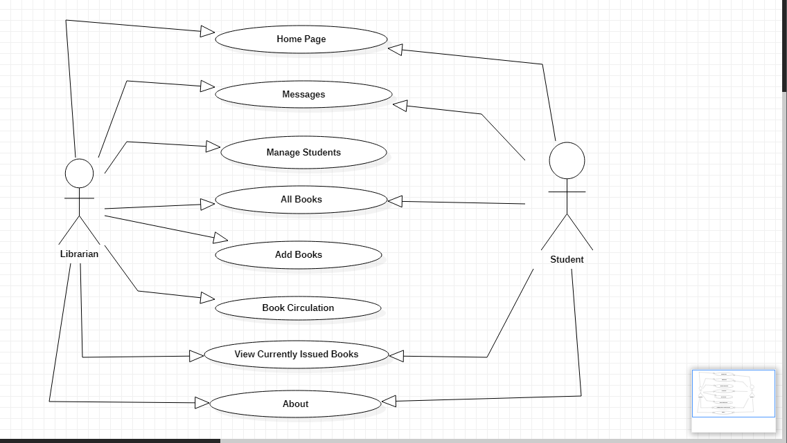
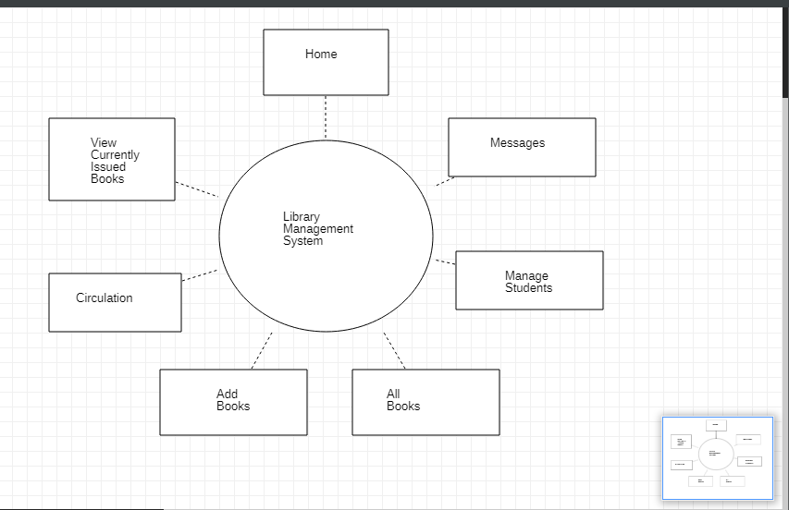
4:-Use Case Diagram
5:-Data Flow Diagram

Slide 11
6:-Content Design
Animation Applied
Sign IN and Sign OUT page
Messaging Students
Adding New Books
Issue and Return Requests
Students Data
View and Search Books
7:-Testing
All the Modules have been Tested Thoroughly and are Working fine for a Static Website
8:-Extra-Curriculum
Sending Warning Messages to a student one day prior to the deadline of returning the issued Book.

Slide 12
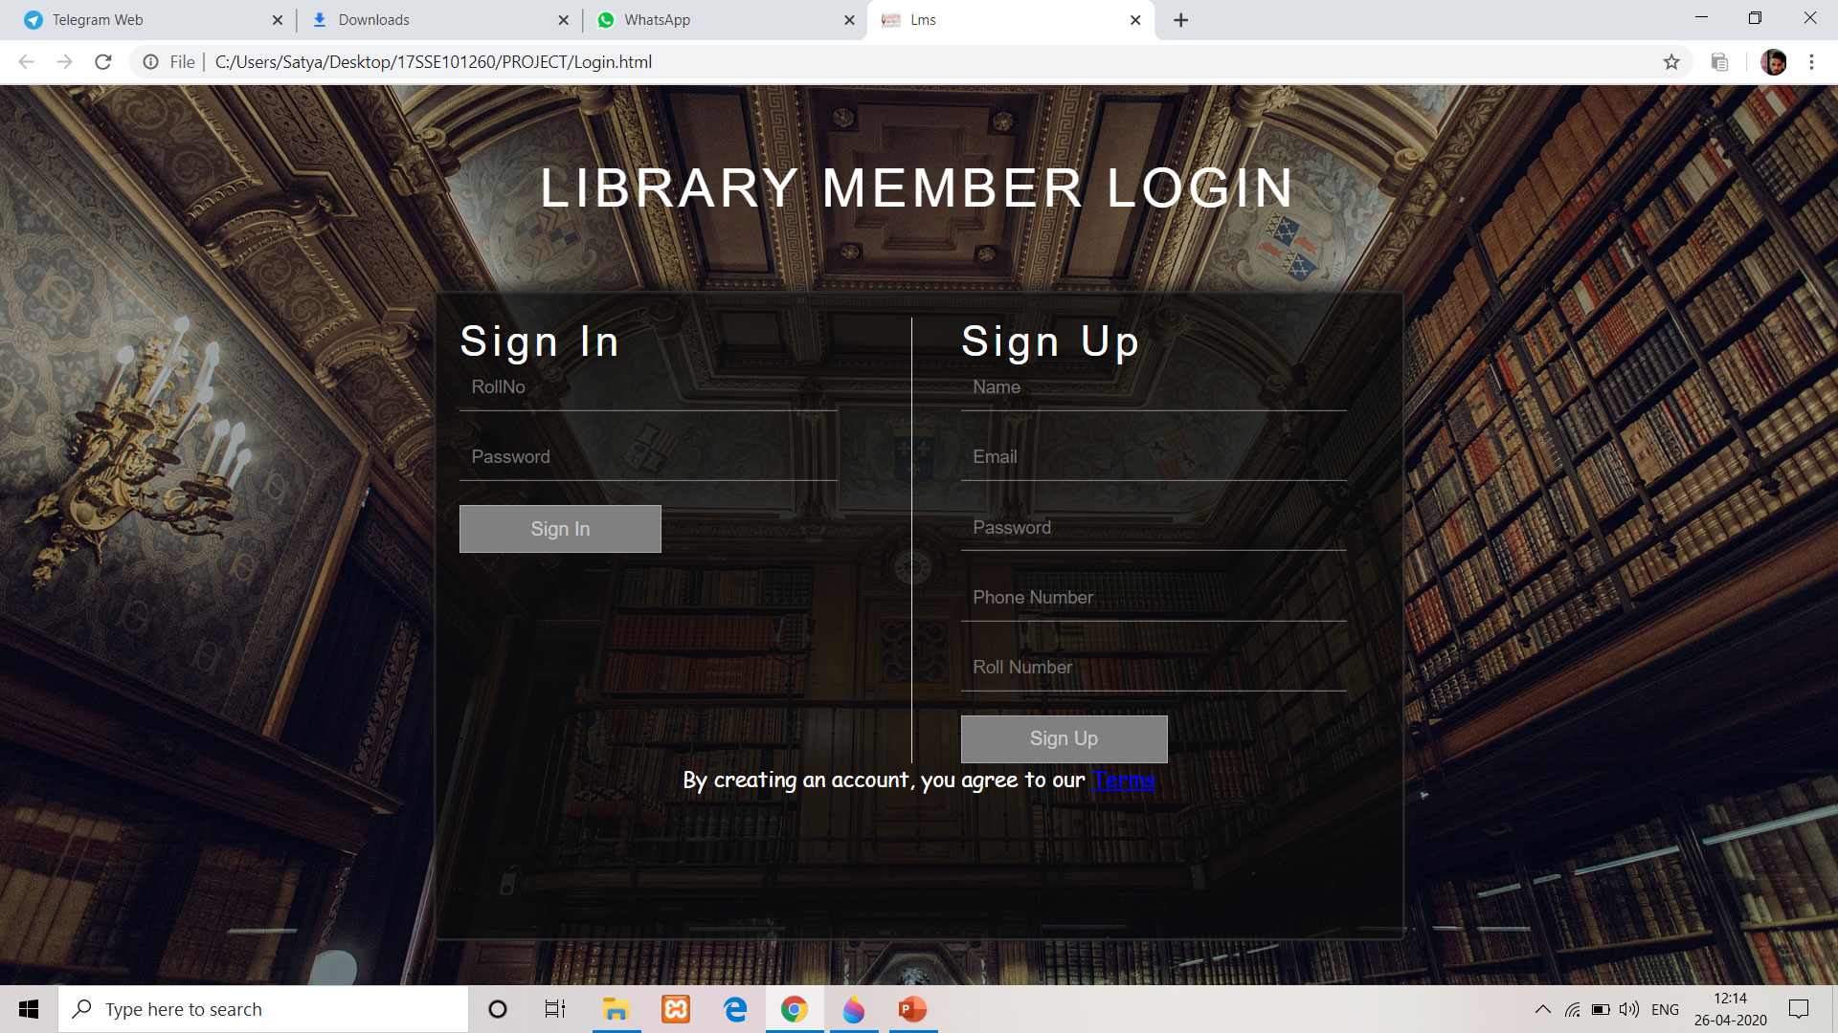
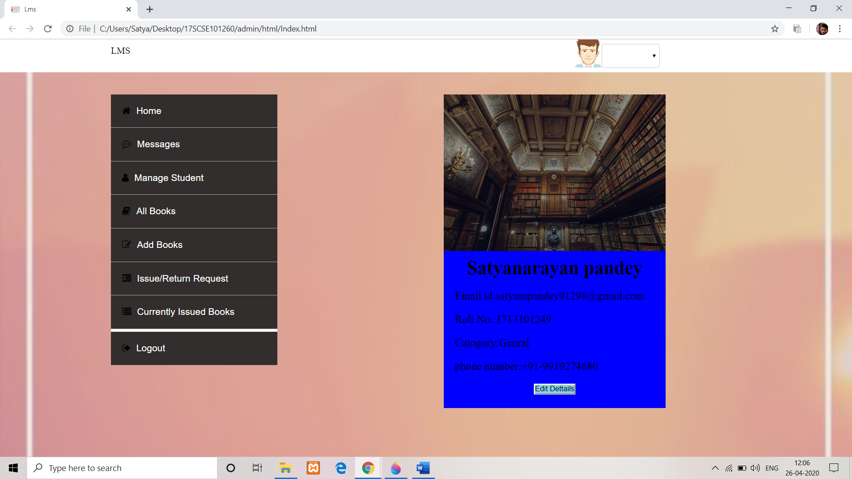
9:-Screenshots

Slide 13
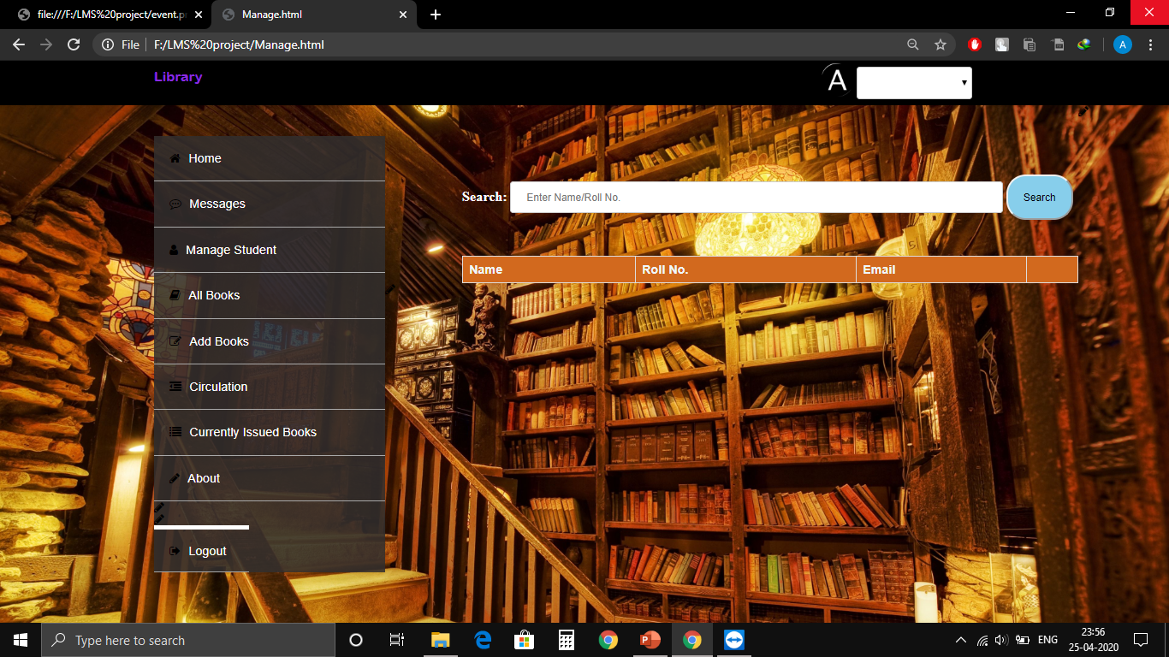
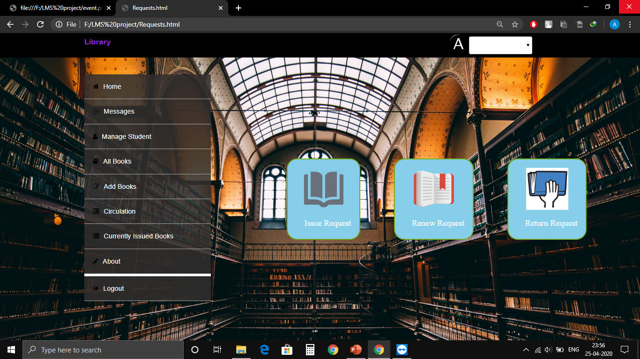

Slide 14


